Slide 1
social-network / team-standards
Team Development Workflow
How we document, branch, commit, migrate, and collaborate
docs
→
branches
→
commits
→
pull requests
→
main
+ database migrations
+ team responsibilities
Notes:
Welcome everyone. This deck covers how we work together from now on: docs, branching, commits, migrations, and who owns what.

Slide 2
01 / DOCUMENTATION
Why we have a docs/ folder
docs/
├── architecture
├── database
├── migrations
docs/ is the project's knowledge base — not just code documentation.
├── git-workflows
├── technical-decisions
?
What did we build?
├── problems-and-solutions
?
How did we build it?
└── things-we-learned
?
Why did we build it this way?
?
What did we learn?
This is also where the final README.md will come from — we write it once, as we go.
Notes:
docs is our knowledge base, not just code comments. It should capture what, how, why, and what we learned.

Slide 3
01 / DOCUMENTATION
What should be documented?
Document
Don't document
Important systems
Every tiny fix
Architecture decisions
Every small code change
Difficult problems and solutions
Routine changes with no long-term value
New technologies or concepts
Development standards
Important project structures
"If it will help us understand, maintain, explain, or learn from the project later — document it."
Notes:
Not every change needs a doc. Document things that will matter later.

Slide 4
02 / BRANCHING
Our Git branching strategy
main
│
├── feat/groups-events
1
Branch from latest main
├── feat/posts-privacy
↓
├── feat/followers-requests
├── feat/chat-private
2
Work on it
├── fix/auth-session
↓
└── docs/git-workflow
3
Commit
↓
4
Push
↓
5
Pull Request → Review → Merge into main
never develop directly on main
Notes:
No develop branch. main is the only long-lived branch. Everything flows through a PR.

Slide 5
02 / BRANCHING
Branch naming
type/scope-description
feat/groups-events
feat/
fix/
refactor/
docs/
test/
feat/posts-privacy
feat/followers-requests
chore/
build/
ci/
feat/websocket-core
fix/auth-cookie
docs/database-schema
refactor/database-migrations
BAD
GOOD
my-branch
feat/groups-events
work
fix/auth-cookie
person1
final2
Notes:
Branch names follow type/scope-description, mirroring commit format.

Slide 6
02 / BRANCHING
Keep branches small
One branch = one clear task
✕
feat/groups
✓
feat/groups-create
Smaller Branch
✓
feat/groups-members
↓
✓
feat/groups-join-requests
Easier Review
✓
feat/groups-invitations
↓
✓
feat/groups-events
Fewer Merge Conflicts
↓
Easier Debugging
↓
Cleaner History
Notes:
One branch, one task. Smaller branches are easier to review and debug.

Slide 7
03 / COMMITS
Conventional commits
type(scope): short description
feat(groups):add group creation endpoint
feat
(groups)
add group creation endpoint
= TYPE
= SCOPE
= DESCRIPTION
feat
fix
docs
refactor
style
test
chore
perf
build
ci
Notes:
type(scope): description. This makes history readable like a changelog.

Slide 8
03 / COMMITS
Choosing the correct commit type
feat
fix
refactor
new functionality
correcting broken behavior
restructure, same behavior
feat(chat): add private messaging
fix(auth): fix session cookie expiration
refactor(database): simplify migration setup
BAD
GOOD
update
feat(groups): add group member list
changes
fix(auth): prevent invalid session access
fix
refactor(posts): separate handler and service logic
done
work
Notes:
feat, fix, refactor are the three most commonly confused types.

Slide 9
04 / WORKFLOW
Complete Git workflow
git switch main
↓
git pull
↓
git switch -c feat/groups-events
↓
WORK
↓
git add .
↓
git commit -m "feat(groups): add event creation"
↓
git push -u origin feat/groups-events
↓
Pull Request
↓
Code Review
↓
main
feature branch → Pull Request → main. No direct push to main.
Notes:
This is the full loop, start to finish: branch, work, commit, push, PR, review, merge.

Slide 10
05 / DATABASE MIGRATIONS
Database migration system
Migration CLI
↓
SQLite Migration Runner
↓
Embedded SQL Migration Files
↓
›
Same schema for every developer
SQLite Database
›
Safe schema evolution
↓
›
Rollback support
schema_migrations
›
Version-controlled database changes
›
Consistent across Docker & deployment
Notes:
Migrations keep the SQLite schema consistent across every dev machine, Docker, and production.

Slide 11
05 / DATABASE MIGRATIONS
Migration workflow
BAD FOR TEAM COLLABORATION
OUR SYSTEM
000004_posts
20260828012000_posts
000004_chat
20260828012015_chat
→ collision
→ no collision
go run ./cmd/migrate create create_your_feature_table
go run ./cmd/migrate up
go run ./cmd/migrate version
go run ./cmd/migrate down
go run ./cmd/migrate down-all
Create
→
Write .up.sql
→
Write .down.sql
→
Up
→
Test
→
Down
→
Test
→
Up again
→
Commit
Notes:
We use UTC timestamp versions instead of sequential numbers, specifically to avoid collisions across branches.

Slide 12
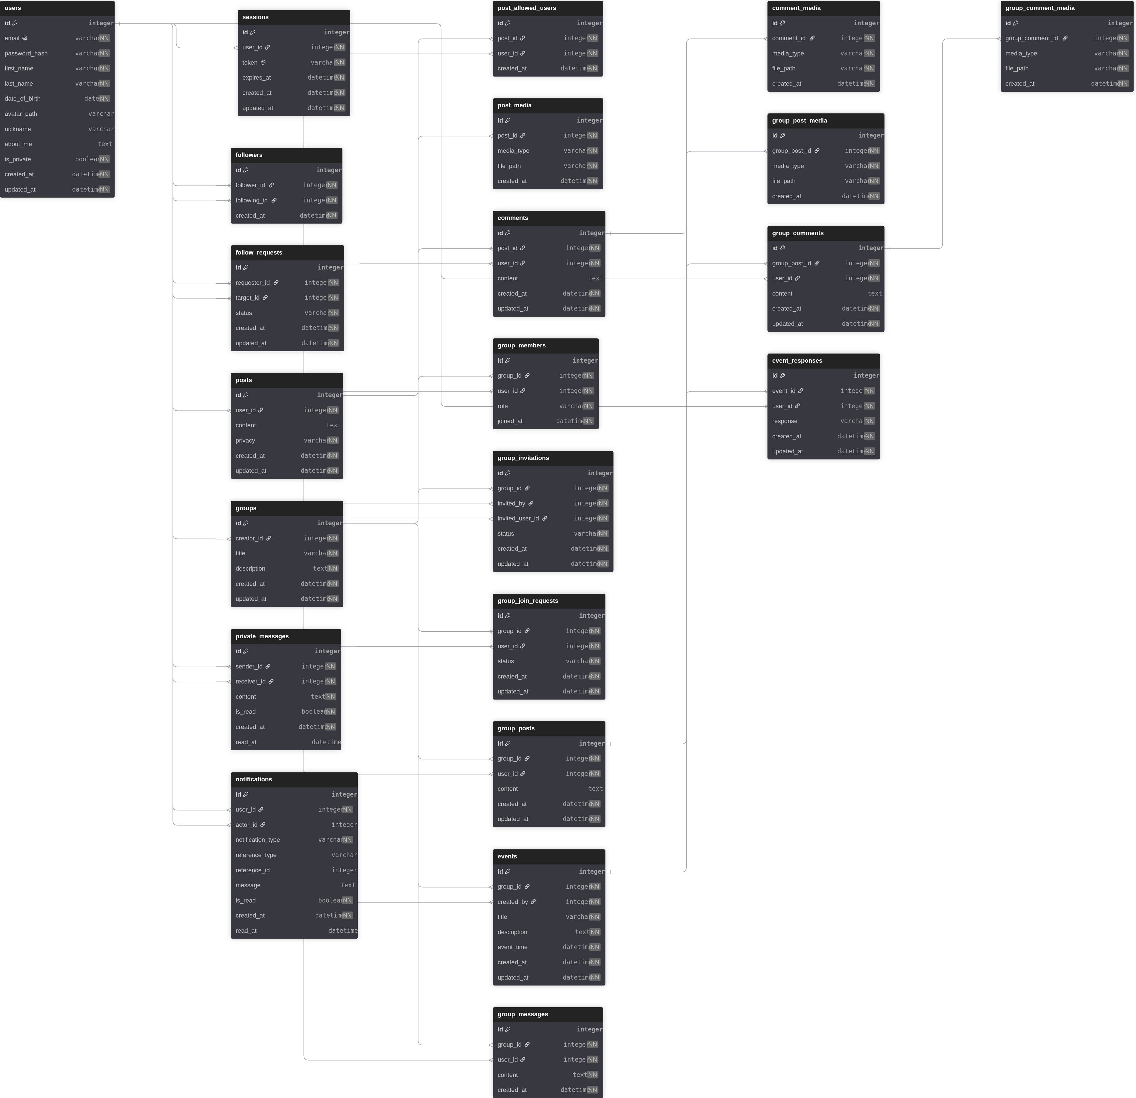
05 / DATABASE SCHEMA
Database Schema
Complete relational structure of the Social Network database
Full schema maintained in schema.dbml
Notes:
The ER diagram is the full relational structure. Complete detail lives in schema.dbml.

Slide 13
05 / DATABASE SCHEMA
Database design as code
schema.dbml
↓
DBML Schema Definition
↓
The schema isn't only an image — it's maintained as text in schema.dbml.
ER Diagram
↓
›
DBML = Database Markup Language
SQLite Migrations
›
Describes tables, fields, types, constraints, relationships as text
›
Stored and reviewed in Git — readable diffs
›
Same source generates the ER diagram
›
Lets the team review the design before writing migrations
schema.dbml is design & documentation — SQL migrations are what actually create and evolve the real SQLite database.
Notes:
The schema is text, not just a picture. It lives in Git and is reviewed before writing migrations.

Slide 14
05 / DATABASE SCHEMA
Working with the DBML schema
VS Code
dbdiagram.io
vscode-dbml — syntax highlighting
Paste schema.dbml contents in to get an interactive ER diagram in the browser.
DBML Live Preview — live ER diagram
No installation required
Open schema.dbml
Interactive browser visualization
↓
Useful for reviewing and discussing the schema
Open DBML Preview
↓
Edit Schema
↓
Diagram Updates
VS Code — best during development, schema stays inside the project, easy to edit alongside the code
dbdiagram.io — no install, interactive visualization, good for reviewing and discussing
Notes:
Two ways to view or edit the schema: VS Code extensions, or paste into dbdiagram.io.

Slide 15
06 / TEAM
Team responsibilities
PERSON 1 · LEADER
PERSON 2
PERSON 3
PERSON 4
Groups + Events
Posts + Comments
Profiles + Followers
Real-Time Systems
Groups
Posts
Profiles
WebSocket Core
Members
Post Privacy
Profile Privacy
Private Chat
Join Requests
Comments
Followers
Group Chat
Invitations
Uploads
Follow Requests
Notifications
Events
Group Posts
Group Comments
Migration
+
Backend
+
API
+
Frontend
+
Testing
— each person owns the complete feature
Notes:
Each person owns their feature end to end: migration, backend, API, frontend, testing. Not backend-only.

Slide 16
06 / TEAM
How our features connect
Groups · Person 1
Profiles & Followers · Person 3
Groups
│
│
+ Followers
├── IsGroupMember()
├── follower checks
│
▼
▼
▼
Group Posts · Person 2
Post Privacy · Person 2
Notification Service · Person 4
Group Chat · Person 4
Private Chat · Person 4
Each feature owns its own business logic. Shared features expose reusable services/interfaces instead of duplicating logic.
Notes:
Features expose reusable checks instead of duplicating each other's logic.

Slide 17
Our goal is not only to finish the project.
Our goal is to build it in a way that we understand, can maintain, and can explain.
Document clearly.
/
Branch clearly.
/
Commit clearly.
/
Review before main.
Notes:
Close with the shared goal: build it well enough that we understand, can maintain, and can explain it.

